Slide 1
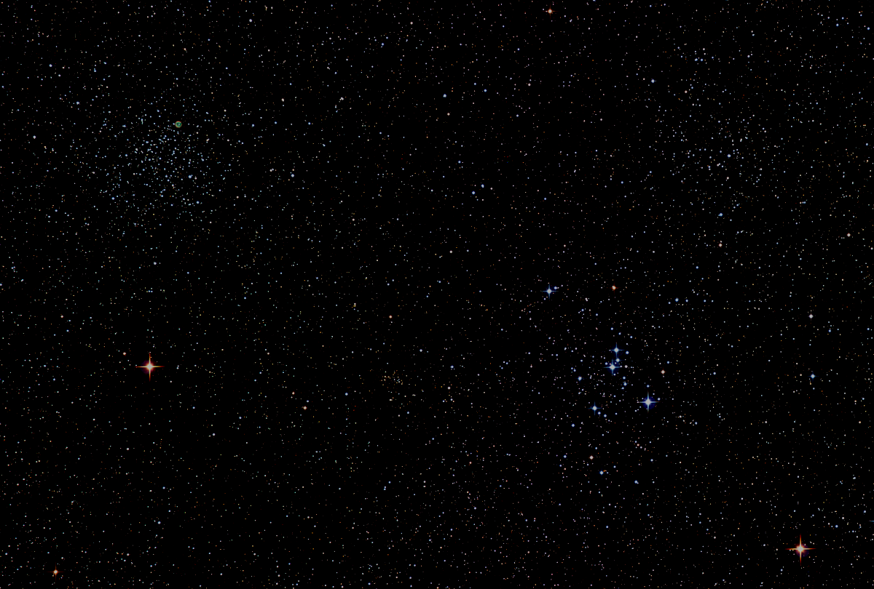

Howard
Astronomical
League
17
October 19th, 2017
Notes:
Howard Astronomical League, Oct 19, 2017

Slide 2
Introductions

Slide 3
Upcoming Events
HAL Events – Alpha Ridge Park
Oct 21st at 6:30pm – Members’ Star Party
Oct 28th at 6pm – Public (STEM) Star Party
Other
Nov 5th – Daylight Savings Time Ends

Slide 4
2018 HAL Elections
Election Committee Chair: Joel Goodman
Elections held at the January 18th general meeting to elect the 2018 Board of Directors
Nominations (self or other) due by 7pm on January 17th, 2018
Nominations and other election communications to election@howardastro.org
New term begins Feb 1st, 2018

Slide 5
HAL Statistics
Memberships: 193 *
Members: 254 *
Impromptu Members: 199 *
Howardastro Members: 386
Facebook Members: 334 *
Website Unique Users: 4416
Unique Users compared to 2017 avg: 3700 (i.e.2nd highest month of the year)

Slide 6
The HAL Board has established two new committees:
  Committee Chairman
  Solar Observing Phil Whitebloom
  Astrophotography Ken Everhart
Blog links forthcoming

Slide 7
This Evening’s Speaker
Dennis Conti
Chair, AAVSO Exoplanet Section
HAL Member
High-Precision Exoplanet Observations with Amateur Telescopes
Notes:
It is my distinct pleasure to introduce Dr. Bindu Rani. She has been a Postdoctoral Fellow at NASA/Goddard Space Flight Center since July 2016, and will continue to hold that post until June 2019. She was also a Postdoctoral Fellow at the Max-Planck-Institut für Radioastronomie Bonn, Germany from February 2014 to June 2016. She has held visiting scientist and researcher positions at the Korean Very Long Baseline Interferometry Network of the Korea Astronomy and Space Science Institute, and The Gra-dig-nan Bordeaux Nuclear Research Center in France. Dr. Rani has experience in Gamma-ray, X-ray, optical, and radio astronomy. Her optical observational experience includes use of the 1.04 meter telescope at AIRES, Na-in-i-tal, India, and the 1.20 meter telescope at Mount Abu, India.
Among her many achievements, Dr. Rani was awarded the Otto Hahn Medal for outstanding scientific achievements by the Max Planck Society in 2015. She holds Bachelor and Master of Science degrees from University of Delhi and Da-yan-and University, respectively, in India. Last, and certainly not least, Dr. Rani completed her Ph.D at Max-Planck-Institut für Radioastronomie and University of Köln, both in Germany in 2013.

Slide 8
Member’s astrophotos
and sketches

Slide 9
Herman Heyn, Paris in September

Slide 10
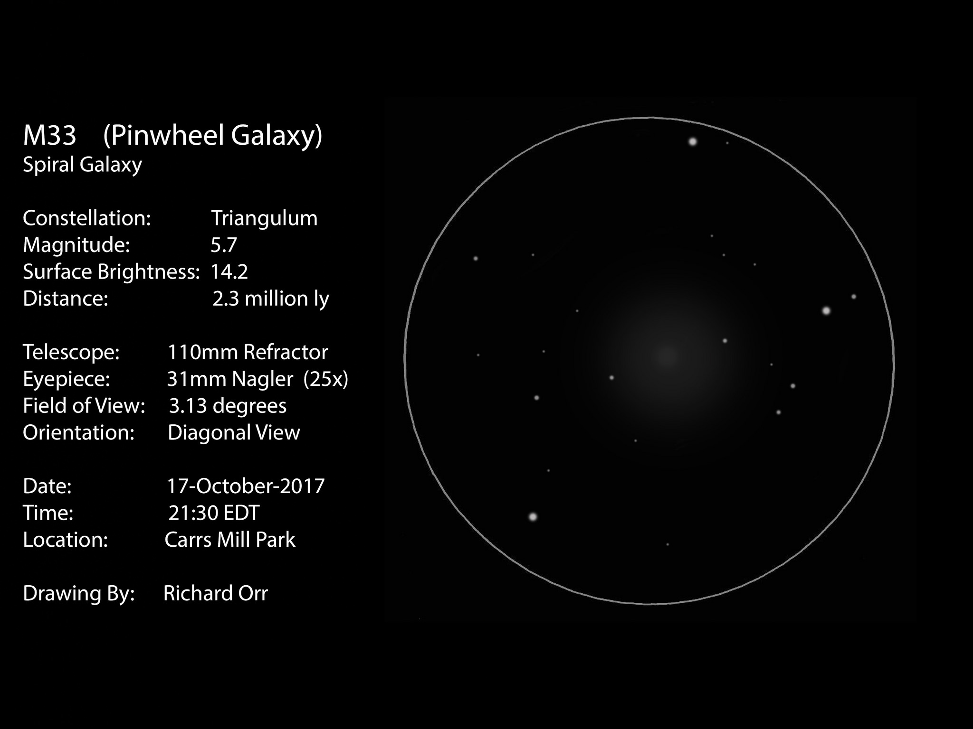

Slide 11
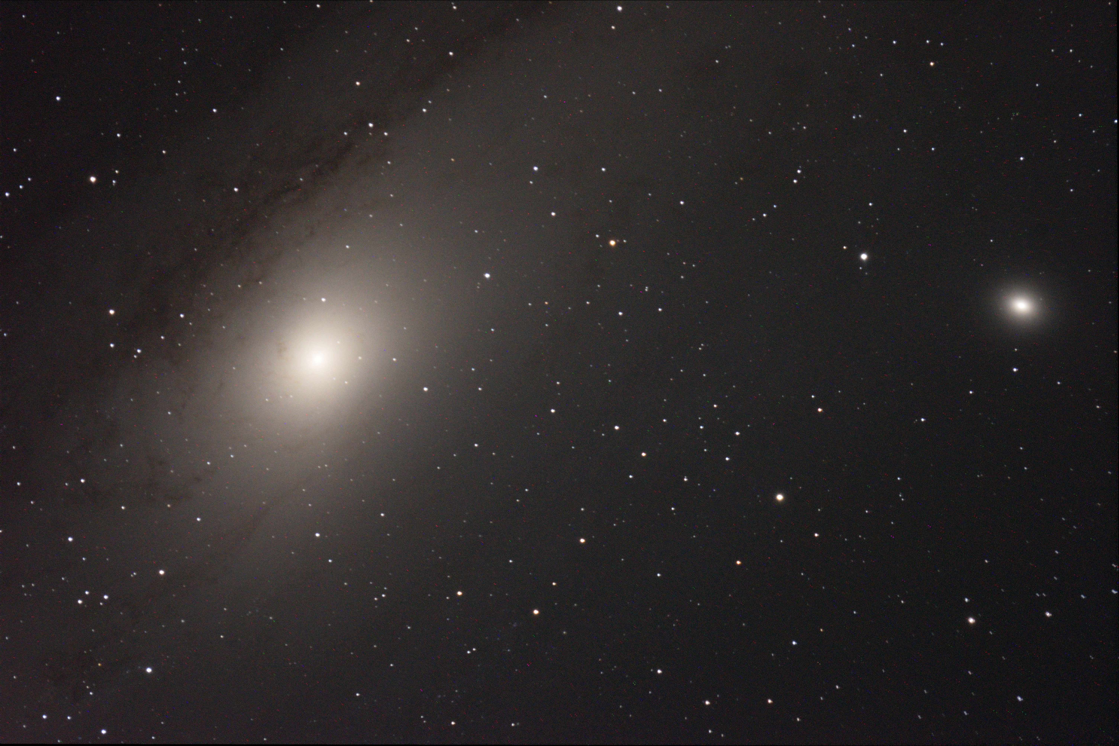
Matt Krutar, Andromeda Galaxy
Notes:
I am relatively new at this, and this is my first test-shot using an auto-guiding setup:
Site: Cars Mill (2017-09-17)
Scope: Celestron EdgeHD 8
Mount: AVX
Camera: Nikon D3300
Autoguider: ZWO120MM attached to Nikon 300mm.
Guiding software: PHD2
2 x 5 Min Exposures

Slide 12
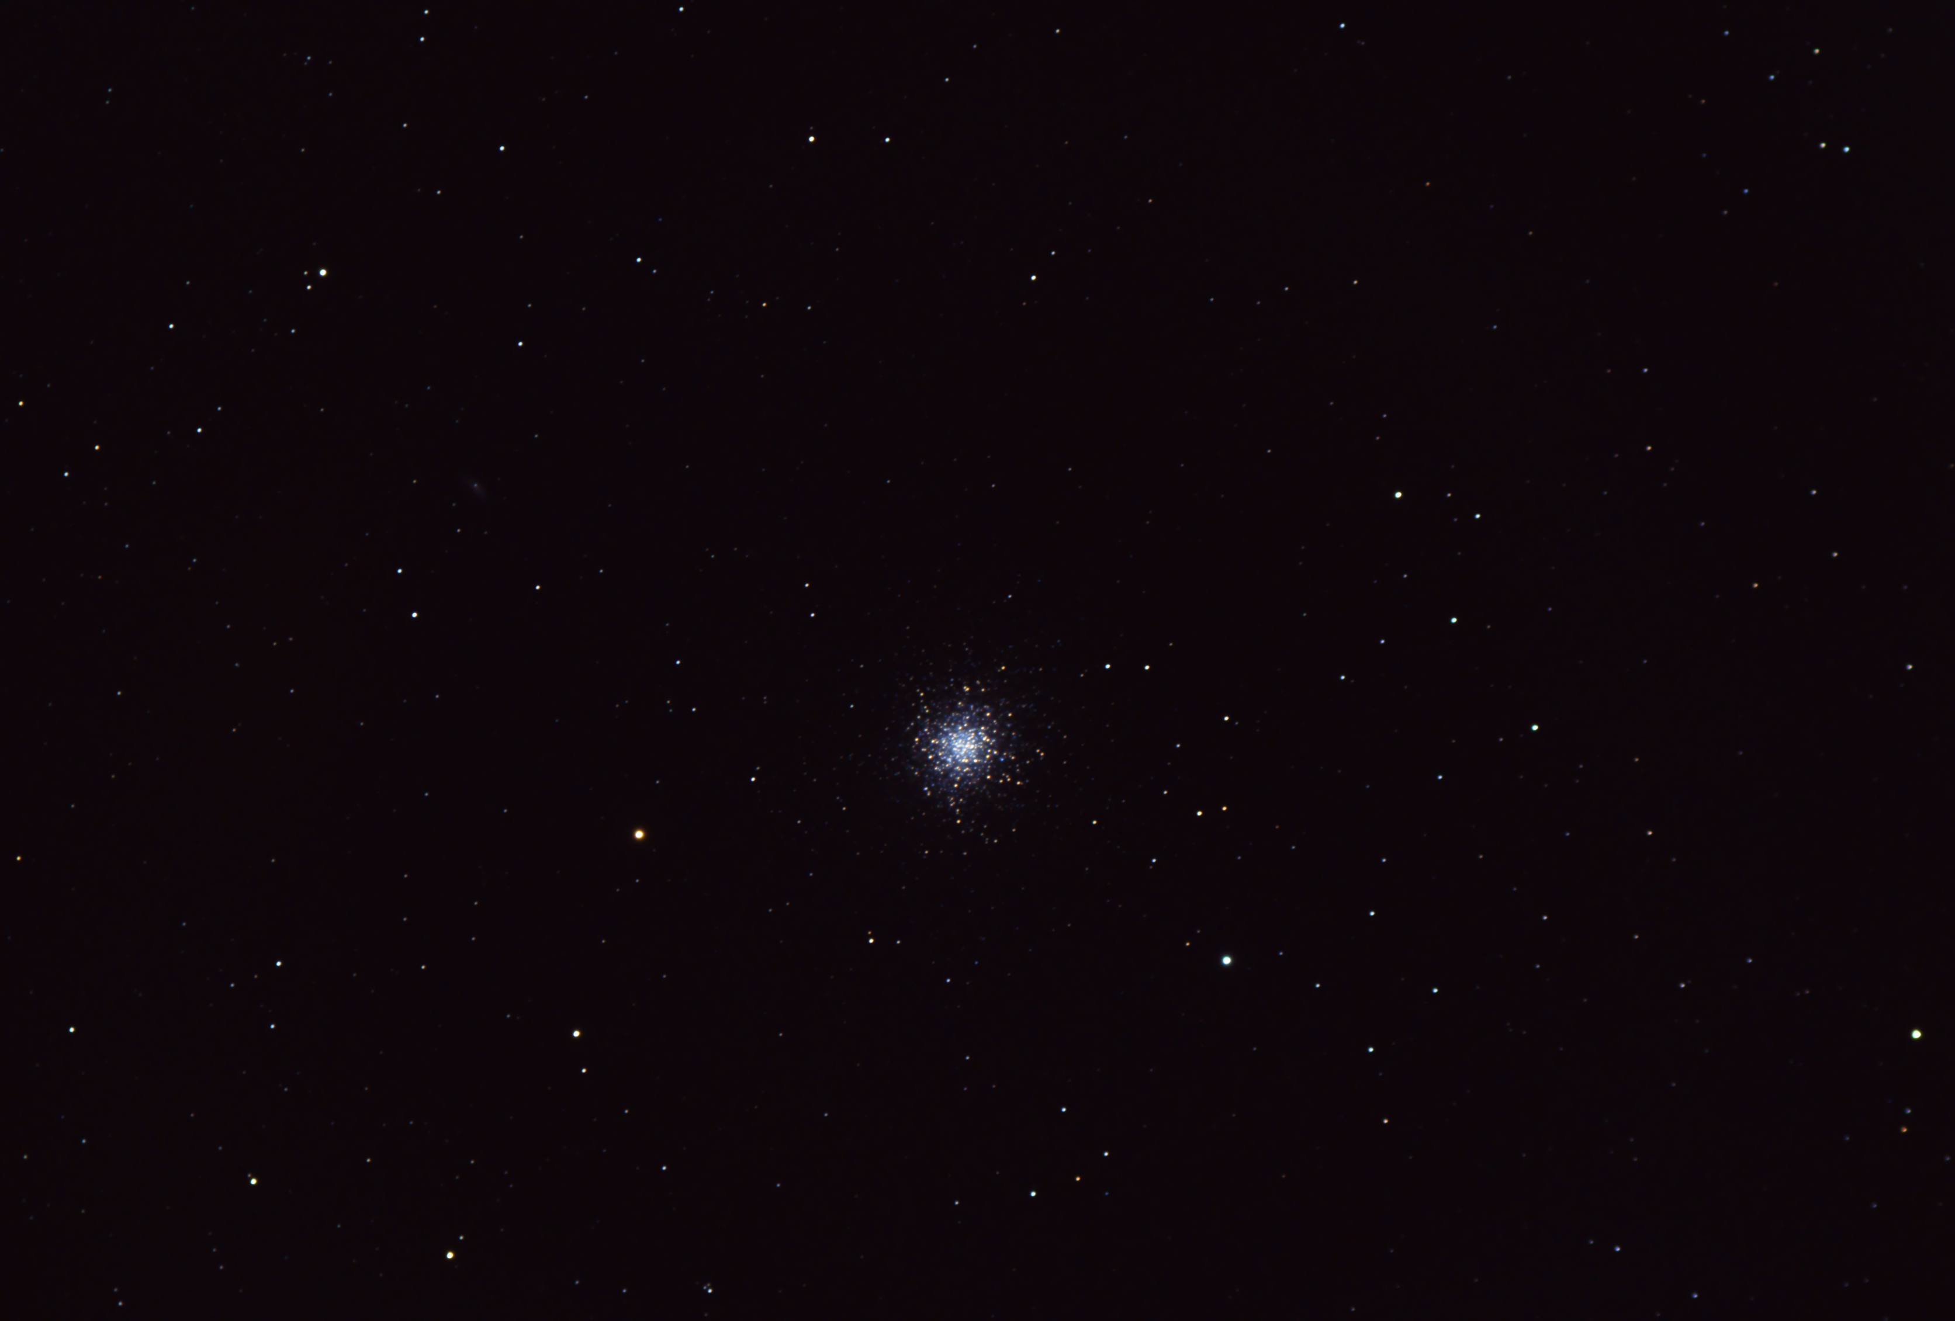
Jim Tomney, M13
Notes:
Equipment:
Vixen ED80sf (80mm f/7.5)
Canon t3i body
Conditions:
October 3, 2017 from Towson (limit naked eye magnitude ~4.2)
Clear, light winds
Seeing 4/5
Transparency 7/10
Imaging:
100 30sec exposures
Stacked in DSS
Processed in PixInsight
Comments:
Pleasantly surprised at result given the light pollution I have to contend with. If you look closely actually picked up 11th magnitude galaxy NGC 6207 (at 10 o’clock position midway between the cluster and edge of the shot).

Slide 13
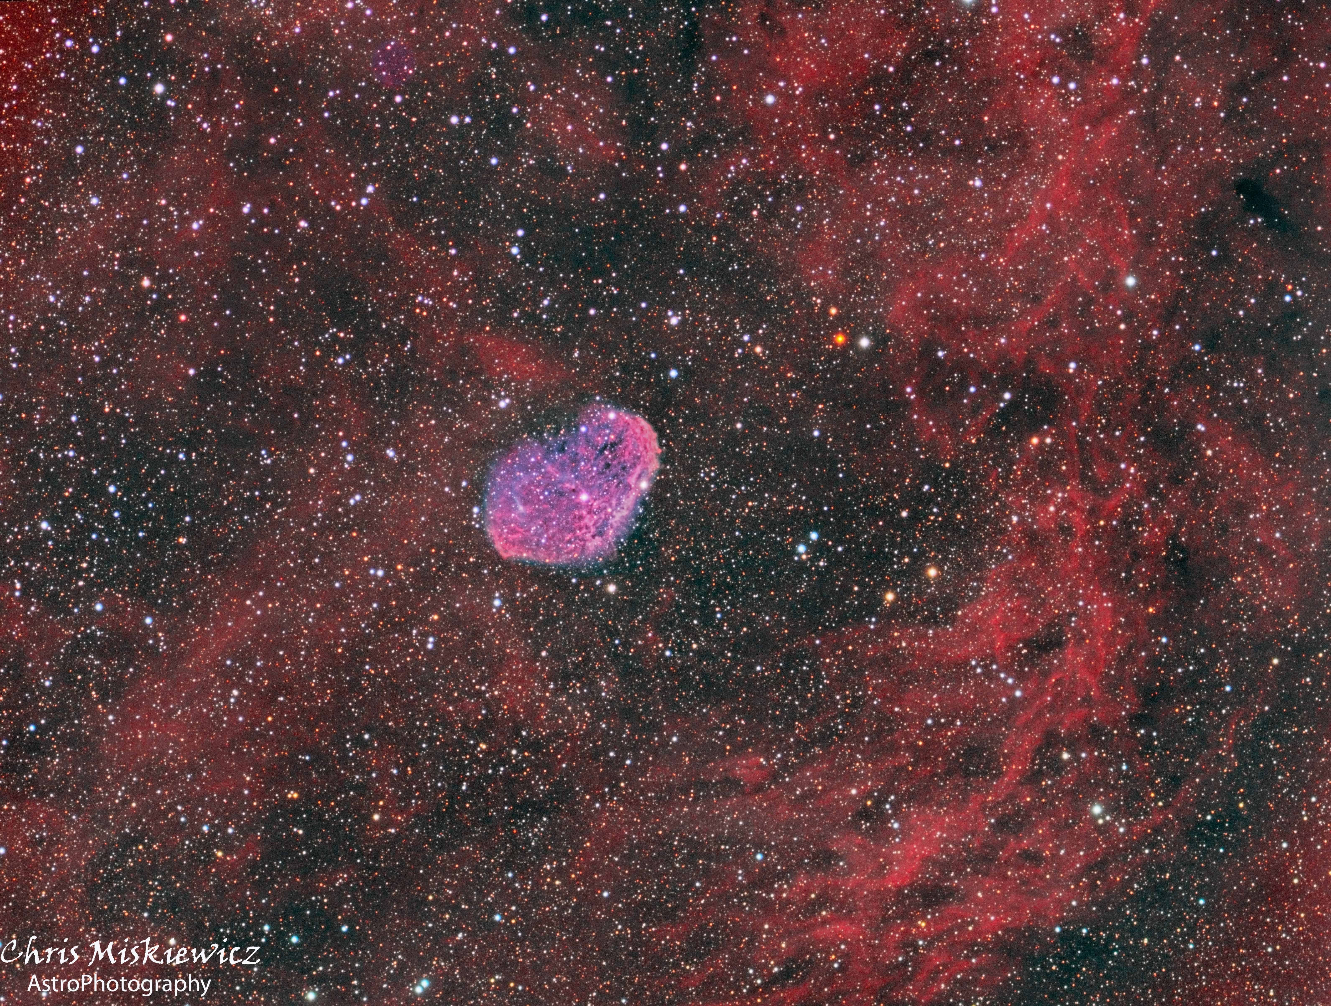
Notes:
Here is my image of the Crescent Nebula from two nights of imaging. The image is a collection of Red Green and Blue plus H-alpha and Oxygen 3 filters for a total of about 6 hours using my Explore Scientific 80mm APO and my QSI camera.
I plan to collect about 6 more hours to bring out the Soap Bubble Nebula which is located at the top of the image about 30% from the side. I didn't realize it was there until I processed the Ha data and it was very faint. Who says astro imagers do not look at their objects, we just do it differently.

Slide 14
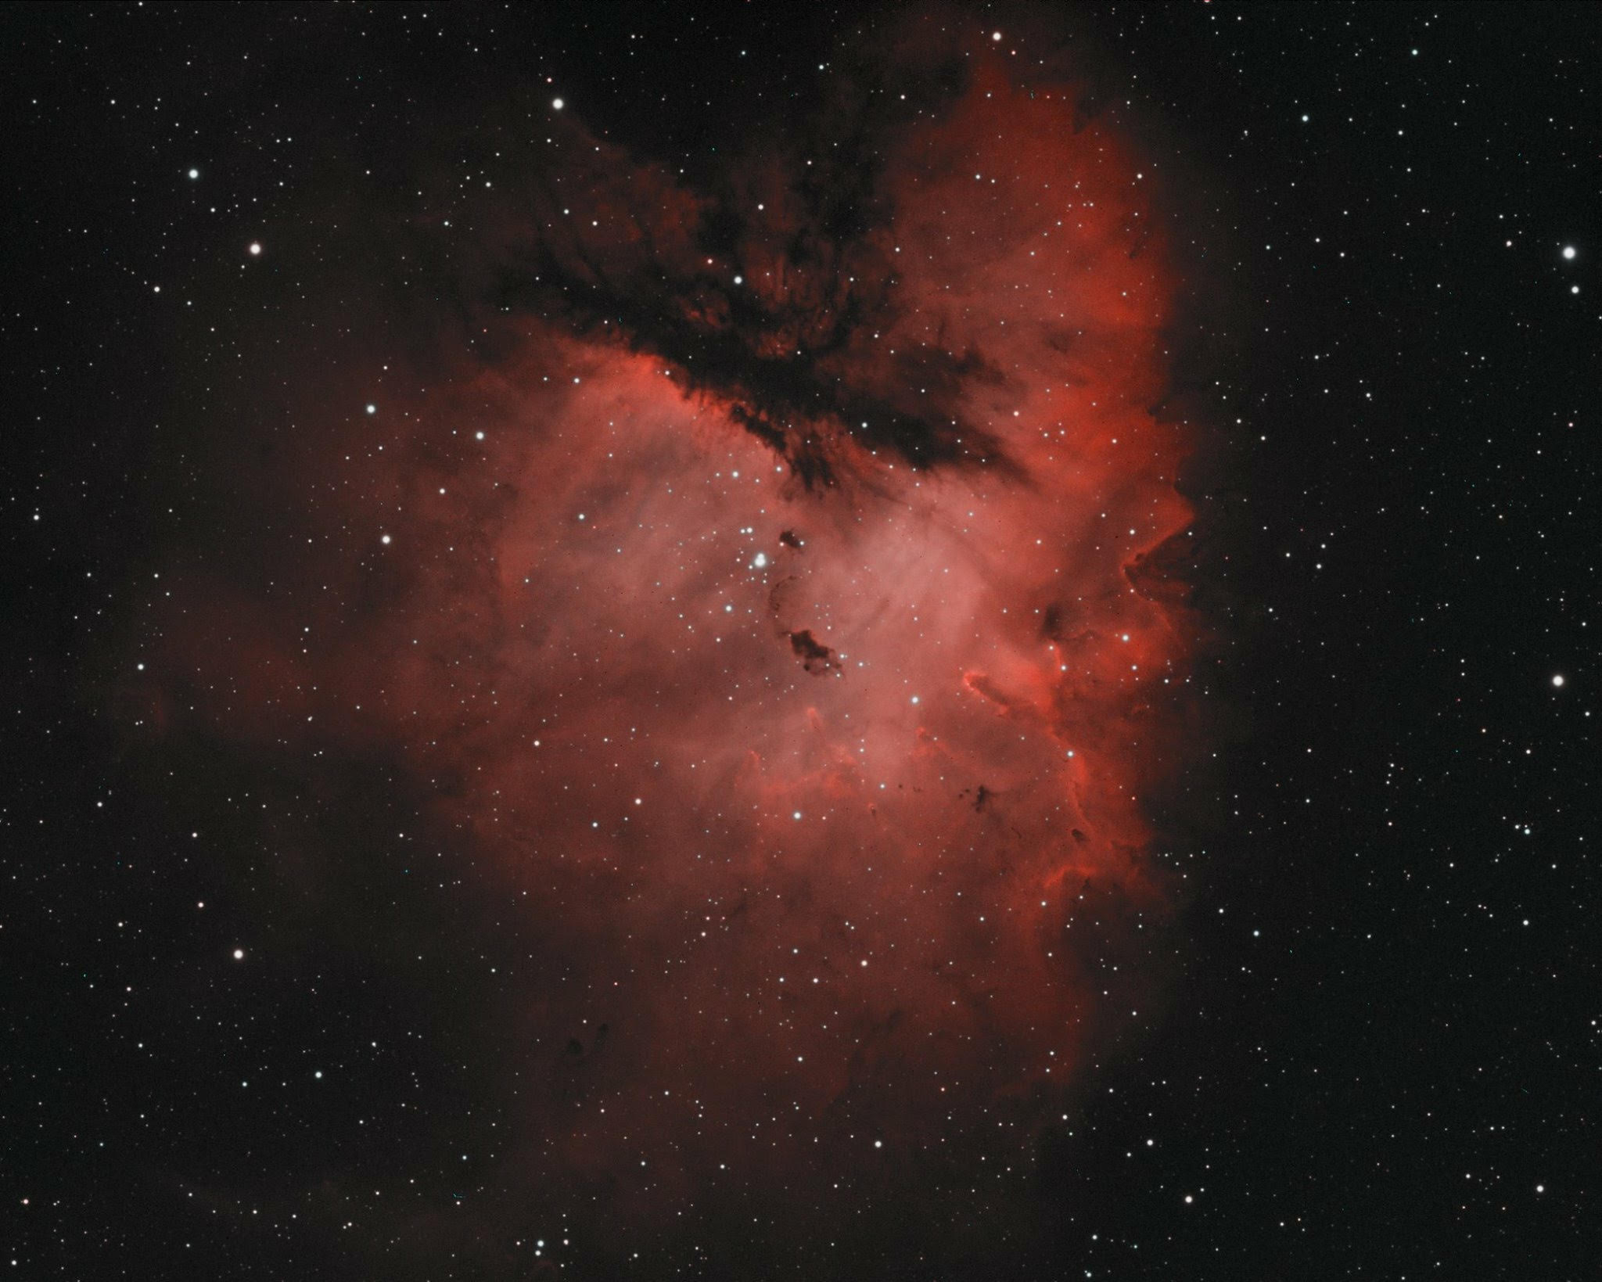
James Stack, IC11

Slide 15
Thank You!
Next month’s meeting is on Thursday, November 16th, 2017 at 7 PM
Ernie Wright
NASA/Goddard Spaceflight Center
HAL Member
Lunar Reconnaissance Orbiter
Science Results

